Slide 1

Weather Analysis
Ramji S

Slide 2
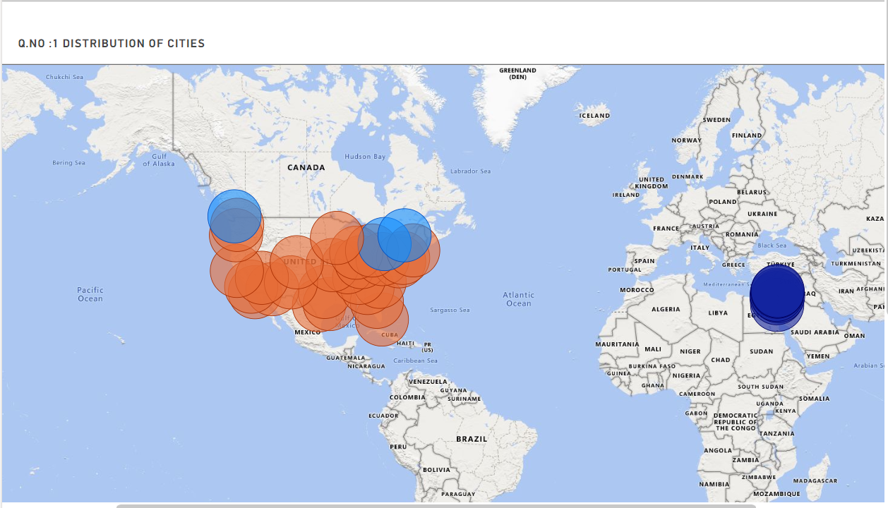
City Distribution : As per the Given dataset it covers the Temperature, Humidity and Wind Speed Analysis of US ,Canada, Israel Cities Bubble Cities are the Spread of location in the world map Mostly USA cities, followed by Canada and Israel Cities .

Slide 3
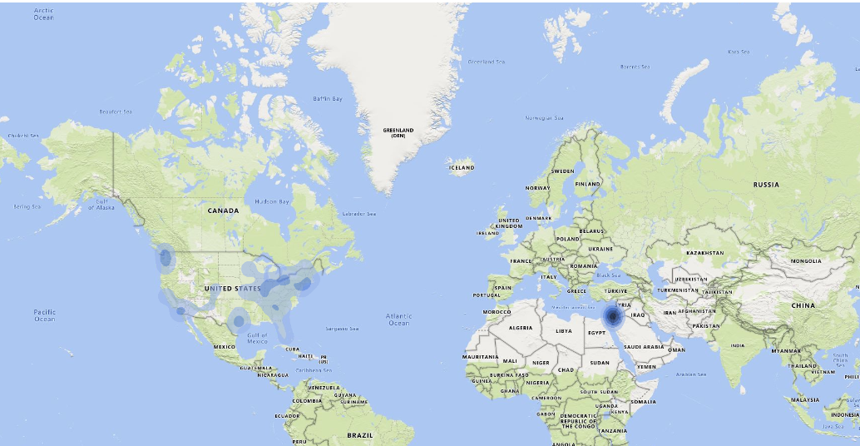
Humidity Part: As per the Humidity Analysis ,Israel has higher humidity when compared with USA and Canada cities . Reason may be major coverage of zones in Coastal cities has higher humidity than the non coastal cities due to sea breeze impact.

Slide 4
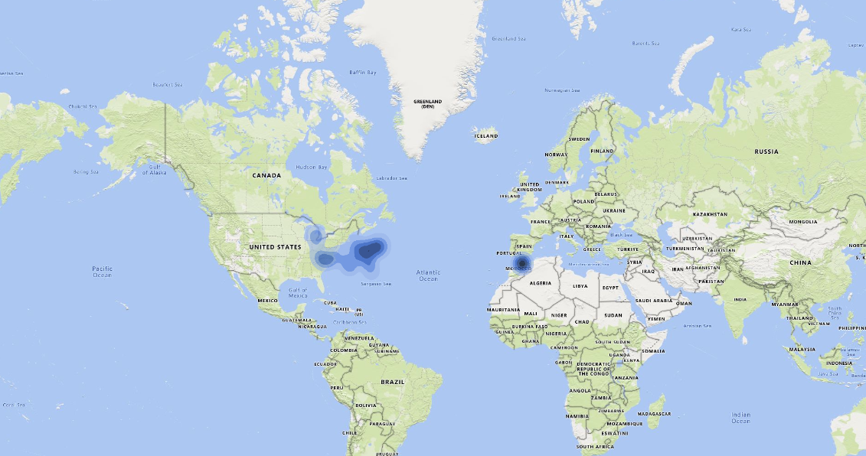
Wind Analysis: As per the Wind Analysis ,We can able to see wind impact in Atlantic ocean which is nearer to Perumada Triangle. Due to Atlantic pressures Wind speed and Wind direction is very dynamic in Perumada Triangle region.

Slide 5
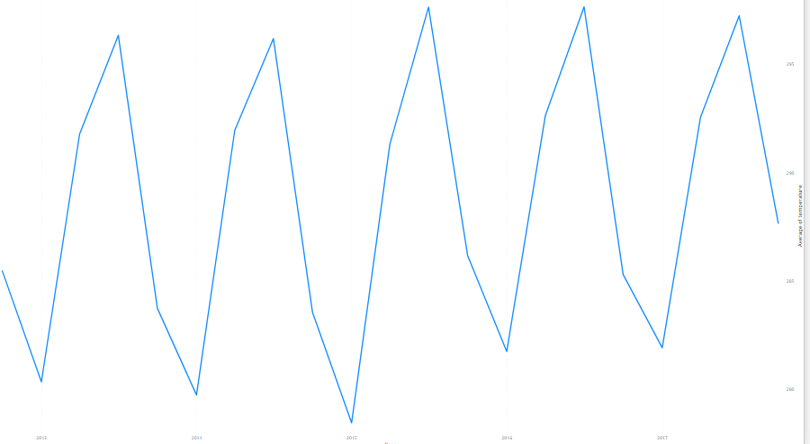
Temperature Trend: From the given chart we can able to see eventhough many natural & man-made factors which affected the Global Climate & weather ,temperature in the particular region remains as a wave trend from 2013 to 2017.

